Slide 1


Real-Estate hub
Developed By
Malak Qeedan - 206770414
Lara Abu Hamad - 322782376
Marwan Hresh - 206467292

Slide 2
about Real-estate hub
Real-Estate Hub is an Android application designed to invest, purchase, rent and post real estate properties.
It is designed to simplify and elevate your real estate experience.
Whether you're a first-time homebuyer, seasoned investor, or property owner, Real-Estate Hub caters to all your needs with unmatched convenience and reliability.
Discover your dream property or find the perfect buyer/renter around the world!
Why Real-estate hub?
Provides investments in worldwide
Efficient Property Search
In-App Advertising

Slide 3


Specialized only in investment real estate
Can invest worldwide
Better user interface
Specialized in multiple topics
Only Israel real estate investments

Slide 4
Roles division
Login
Search Post
App Languages
User Profile
Favorite Page
Add Post
Google Payment API
Home Page
User History
Lara’s Work
Malak’s Work
Frontend | Backend
Marwan’s Work

Slide 5
requirements
 | Functional | Non-Functional
1 | Registration & login | Contact Seller via whatsApp
2 | User Profile | Contact Seller via phone call
3 | Investments | View Property Location in GoogleMaps
4 | Custom Search
5 | Advertising
6 | Save Posts
7 | Track Post
8 | View History

Slide 6
Features
Buy/Invest/Rent Real Estate
Add Post
Custom Search
Track Post

Slide 7
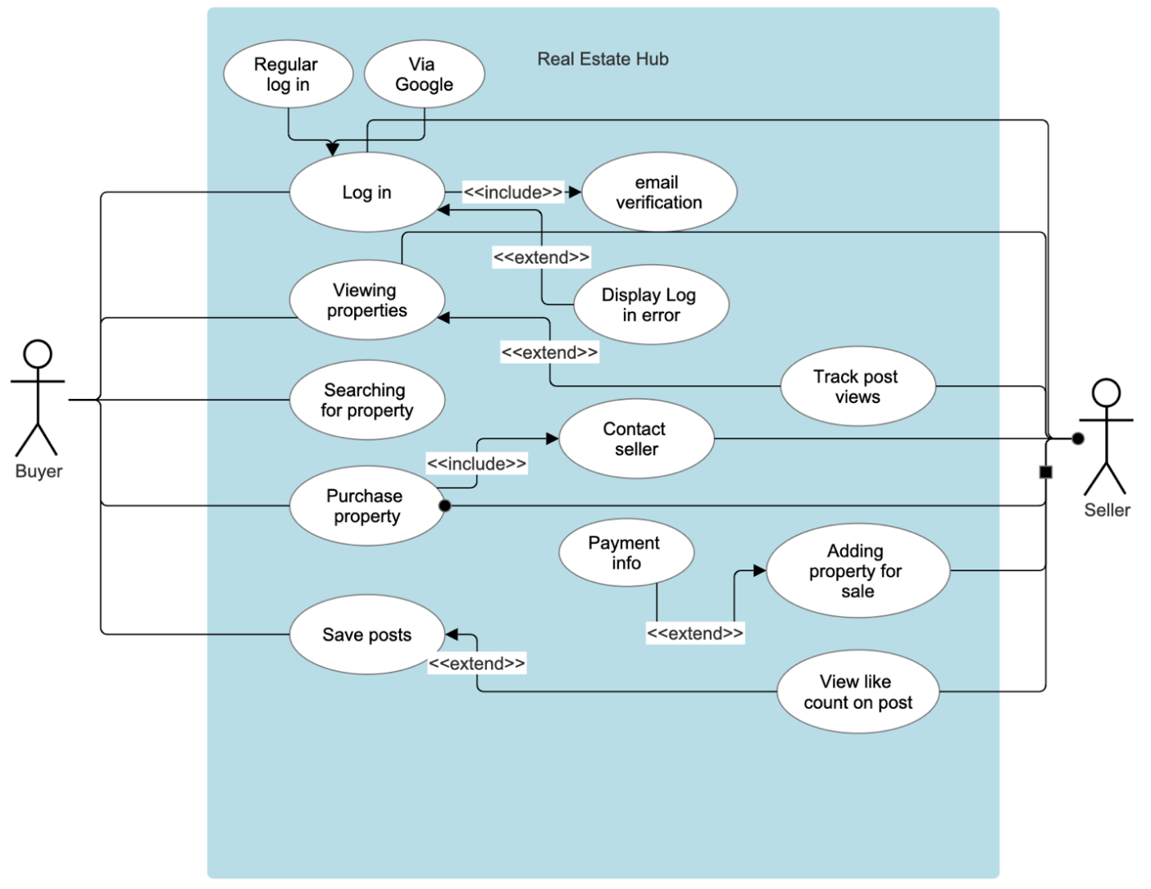
Use Case Diagram

Slide 8
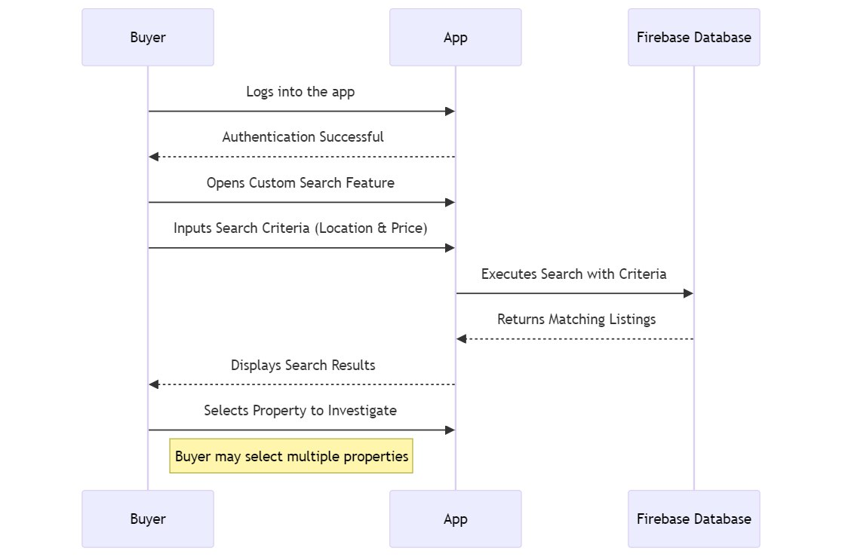
Sequence Diagram – Buyer Making Search

Slide 9
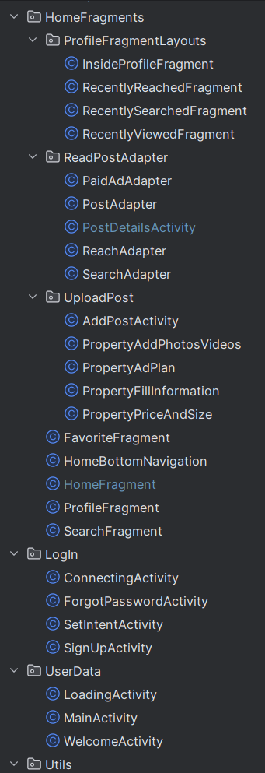
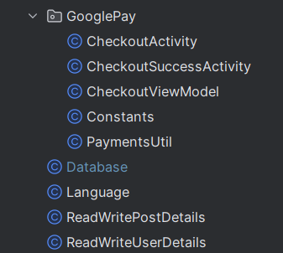
Profile
App structure
show post+History
Upload post
view
Login
User data
Google Pay
Store data

Slide 10
Challenges
Implementing multiple-filter search
For Future Work
Sign up using Facebook
Upload post video
View multiple post photos

Slide 11
Thank you

